Slide 1
“Wake Me Up”
Doug Gilliland
Notes:
<number>

Slide 2

Real World Situation
I wear a CPAP mask
CPAP machine runs all night
The CPAP machine is AC powered
Power fails where in live in SW PA frequently
Sometimes the power goes off and I don’t know it
Often the machine does not go back on after power returns (depends on duration of power outage)
Notes:
<number>

Slide 3
Project Idea
Create a device to monitor AC power
Device needs to wake me up when power goes off
False alarms (power off for too short a time) are OK
LEGAL NOTE: THE PROJECT CONCEPT HEREIN DOES NOT DESCRIBE A MEDICAL DEVICE
Notes:
<number>

Slide 4
Components
AC Powered
Can use AC power as monitoring point
Battery backup
Could use a supercap (initial cost vs maintenance)
Buzzer Alarm
Pushbutton to shut off alarm
Notes:
<number>

Slide 5
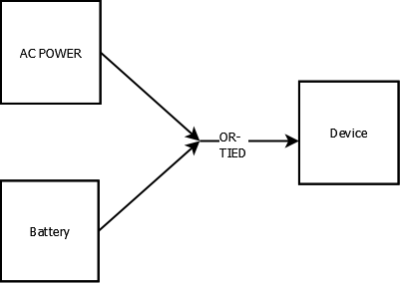
Power Scheme (First cut)
AC/12VDC wall wart
OR-Tied = diode
“Normal” AC/DC supply needs to be higher voltage then the battery supply
Typical battery choice 9V alkaline
When the AC fails, power will be taken from the battery
Notes:
<number>

Slide 6
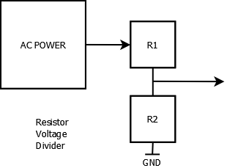
Power Fail Detection
DC wall warts - typically 50 Khz switchers with small capacitance so relatively quick discharge
Scale 12V to somewhere in 1-5V
5/12 ratio (max)
Precision not needed
Use resistive divider
Picked R1=22K, R2=10K
Vout = 5 * 10/(10+22) = 3.75V
Shared ground reference
Notes:
<number>

Slide 7
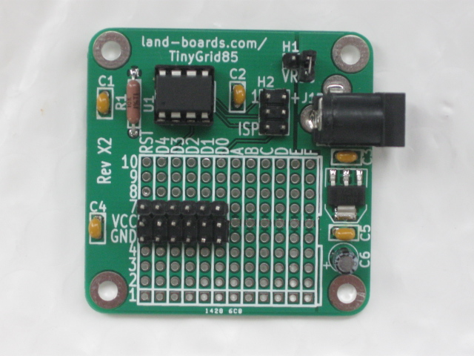
Prototype Platform
Would like some intelligence in the device
Need to prototype quickly
Use my TinyGrid85
“When all you have is a hammer everything looks like a nail” – Baruch's Observation
Notes:
<number>

Slide 8
TinyGrid85 Features
ATMEL ATTiny85 Microprocessor (or compatible 8-pin part) = $1 in volume
Arduino Compatible (works with Arduino bootloader and Arduino IDE)
Prototyping area with power/ground connections
Brings out all 5 I/O lines and the reset line to grid columns
Laid out like a breadboard with vertically connected traces.
Power and Ground horizontal connections though all columns
Labeled (with letter numbers) for easy documentation
H1 - Jumper to select regulator or remove for ISP +5V (could be power switch connector)
H2 - ISP Download Header (ATTiny85-Programming)
AP1117 5V Power Regulator with area for heat dissipation
2.1mm Connector for AC adapter 7-9V input (could be higher)
(4) 4-40 or M3 screw holes for solid mounting
49x49 mm board - low cost of PWB manufacture in China ($15 for 10 cards shipped)
Notes:
<number>

Slide 9
TinyGrid85 Layout
ISP Connector
Power Switch
ATTiny85
CPU
DC Power Jack
Reset Circuit
5V Voltage Regulator
Optional GVS connectors
Prototyping grid
Power/Gnd
connections
Notes:
<number>

Slide 10
Mods to TinyGrid85
Need a diode between the input jack and the regulator
TinyGrid85 has both an input jack and a voltage regulator
But there is a etch on the rear side of the PCB from the input jack to the regulator
Cut etch (XACTO knife) and add diode
Add 9V battery clip and 9V diode
Install GVS headers for switch and buzzer
Add voltage divider resistors
Notes:
<number>

Slide 11
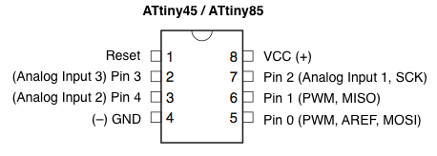
Picking ATTiny85 pins
ISP uses D0-D2 but they can be used by functions on card as long as they are not hard wired to ground
5 Digital I/O pins, but…
Only certain pins can be analog inputs
Voltage divider needs to go to analog input line
Only certain pins do PWM
Might want to use PWM to control the buzzer
Notes:
<number>

Slide 12
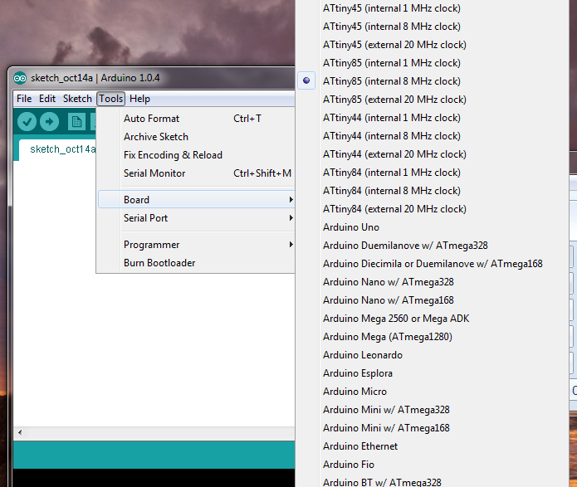
Programming Wake Me Up
Arduino IDE doesn’t have built in support for the ATTiny85
http://land-boards.com/blwiki/index.php?title=ATTiny85-Programming
Once set up the ATTiny85 gets added as a board selection in the IDE
Notes:
<number>

Slide 13
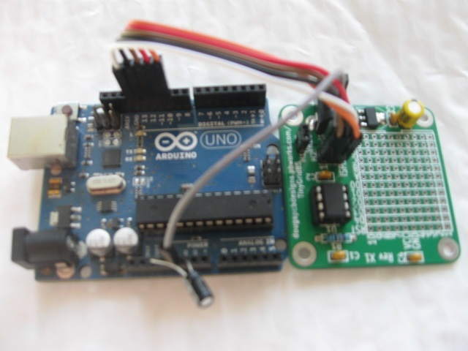
Programming (pt 2)
Use ISP programming header
I have my own homebrew ISP programmer
Can also program from an Arduino UNO
Notes:
<number>

Slide 14
Code Design – First Pass
First validate the parts all work
Buzzer buzzes under program control
Switch can control buzzer
Power fail is detected
Notes:
<number>

Slide 15
Arduino Code – 2 Functions
“Normally” C calls main(), not the Arduino…
All Arduino code has two functions which must be provided
setup( ) – run at start-up
loop( ) – runs over and over from start to end
The hidden code in the Arduino environment is:
setup()
while (1)
loop()
Notes:
<number>

Slide 16
Arduino Code
// WakeUp
// Hardware
const int BUZZER = 0;
const int BUTTON = 3;
void setup()
{
pinMode(BUZZER, OUTPUT);
pinMode(BUTTON, INPUT);
}
void loop()
{
int sensorValue;
int loopCount;
sensorValue = analogRead(2);
if (sensorValue < 512) // 2.5V
{
digitalWrite(BUZZER, HIGH);
for (loopCount = 0; loopCount < 100; loopCount++)
{
delay(100);
if (digitalRead(BUTTON) == 0)
loopCount = 100;
}
}
else
digitalWrite(BUZZER, LOW);
}
Notes:
<number>

Slide 17
Constants and Globals
Constants and/or globals are true in all .ino files
C scope rules are different
Comments begin with //
Hardware pin numbers
// Hardware
const int BUZZER = 0;
const int BUTTON = 3;
Notes:
<number>

Slide 18
setup( ) Code
Function name
No variables passed
No value returned
Configure pins
void setup(void)
{
pinMode(BUZZER, OUTPUT);
pinMode(BUTTON, INPUT);
}
Notes:
<number>

Slide 19
loop( ) Code
void loop()
{
int sensorValue;
int loopCount;
sensorValue = analogRead(2);
if (sensorValue < 512) // 2.5V
{
digitalWrite(BUZZER, HIGH);
for (loopCount = 0; loopCount < 100; loopCount++)
{
delay(100);
if (digitalRead(BUTTON) == 0)
loopCount = 100;
}
}
else
digitalWrite(BUZZER, LOW);
}
Temporary variables
Read the divider
If the AC is low
Buzz the buzzer
100x100 ms loop = 10 seconds
If button is pressed
terminate loop early
Shut off the buzzer
Notes:
<number>

Slide 20
Demonstration
Pull the AC plug simulating power failure
Buzzer buzzes
Press switch to stop buzzer
Buzzer will stop on its own in 10 seconds if there is no switch press
Notes:
<number>

Slide 21

Kickstarter Rules
Why not just kickstarter it without making a prototype?
Notes:
<number>

Slide 22
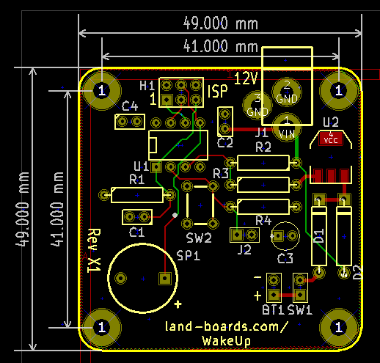
First Article Board Layout
ISP conn.
ATTiny85
Switch
Buzzer
DC jack
5V reg
Diodes
9V clip
Ext Switch
Pwr (top)/Gnd (bottom)
Flood filled areas
Notes:
<number>

Slide 23
Next Steps
PWM control of buzzer
Attack decay sound patterns?
Increasingly loud?
“Can’t wake the dead”
Battery test without wearing down battery?
Low battery level LED
Packaging?
Add other status LED?
Short buzz at power on?
Estimate BOM cost, sell price = pi * BOM cost
Notes:
<number>

Slide 24
Thoughts/Suggestions
Any thoughts or suggestions for improvement?
Notes:
<number>

